Slide 1
CSC207 Project
Group 047
Yicong Luo, Khloe Tsang, Wenzhen Wang, Peijun Lu, Qin Xu, Zhaoyu Yan

Slide 2
Specification
Grocery order reservation app
Phase 0
Registration and login
Phase 1
View and order groceries
Add and remove items from shopping cart
Check out order and confirm pickup
Phase 2
Change username and PIN
Payment and credit system
Order history
Colour settings

Slide 3
Design Decisions
Renaming of classes
Extraction of some parts of controller classes into gateways and presenters
Change of text file location

Slide 4
Clean Architecture
Used the Dependency Inversion technique (see pull request #75) to ensure dependency is from low level modules to high level modules
(Continued on next slide)

Slide 5
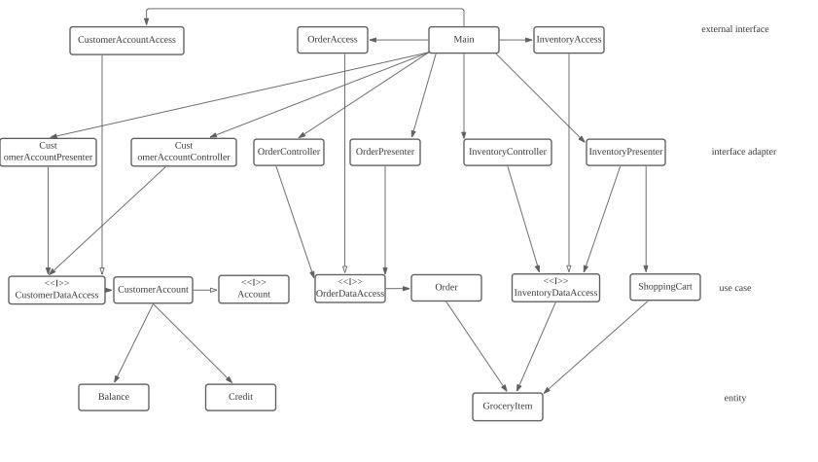
Clean Architecture (cont.)
UML diagram as seen below

Slide 6
SOLID Principles
Single Responsibility Principle
All classes only have one responsibility
Open/Closed Principle
No action will alter existing classes
Liskov Substitution Principle
Our Controller classes use a Data Access interface at the use case level, but in actual usage we use the Main class to pass a concrete class that implements the interface
(continued on next slide)

Slide 7
SOLID Principles (cont.)
Interface Segregation Principle
No classes contain features they don’t need, and all concrete classes that implement an interface override and use the corresponding methods
Dependency Inversion Principle
Our Data Access classes are in the outermost layers, and their interfaces are in the use case layer

Slide 8
Design Pattern
Iterator Pattern
Used in our three Presenter classes
See Pull requests #91 and #96
Dependency Injection Pattern
Used in our controller classes

Slide 9
Package Strategy and Code Refactoring
Classes are put into packages by four layers, from high level to low level
entity
use_case
interface_adapter
external_interface
Another folder named ‘file’ to store text files under database
Combined classes with the same responsibility (see pull request #22)
Shorten long methods (see pull request #46)

Slide 10
Accessibility
Equitable use
Three text colour options to make user experience more equitable
Flexibility in use
Not applicable at current stage as the program can only be used in command line, can be implemented in later stages
Simple and intuitive use
In-app instructions are clear, short, and easy-to-understand
Perceptible information
Different coloured messages to allow for easy distinguishability of information
(continued on next slide)

Slide 11
Accessibility (cont.)
Tolerance for error
Warning messages for bad input
Low physical effort
Only requires integer input from the user
Serialization for colour settings
Size and space for approach and use
Not applicable at current stage, but can be implemented in later stages

Slide 12
Open questions
How do we test the UI with user input?

Slide 13
Thank you!

